Slide 1
Chapter 15. Query Processing

Slide 2
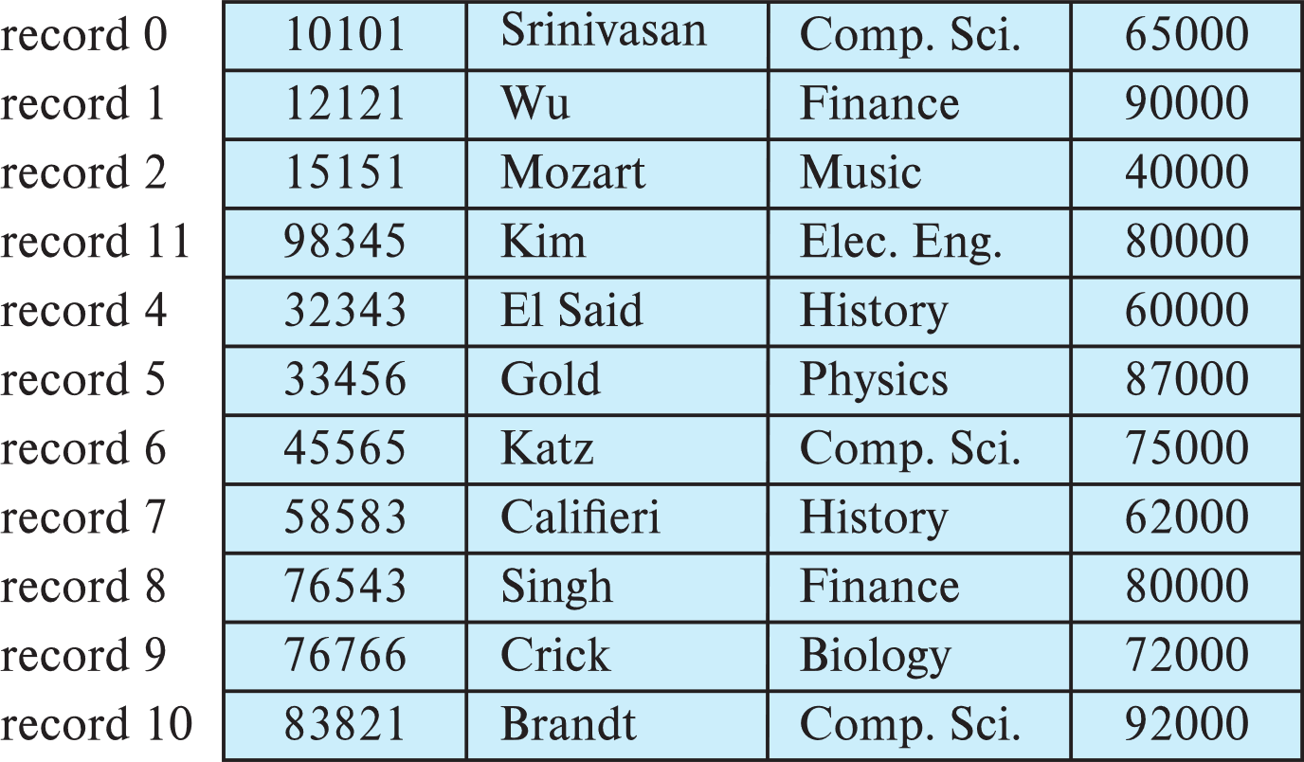

Linear Search
A1: No index (p. 15.10)
Cost = b_{r} block transfers + 1 seek = t_{S} + b_{r} * t_{T}
(equality on key), cost = (b_{r} /2) block transfers + 1 seek = t_{S} + b_{r}/2 * t_{T}

Slide 3
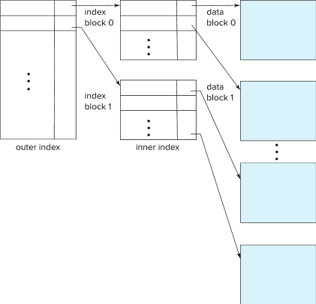
Index Scan
A2: Clustering index, equality on key (p. 15.11)
Cost = (h_{i} + 1) * (t_{T} + t_{S}) = h_{i} * (t_{T} + t_{S}) + t_{S} + t_{T}

Slide 4
A3: Clustering index, equality on nonkey (p. 15.11)
Cost = h_{i} * (t_{T} + t_{S}) + t_{S} + b * t_{T}

Slide 5
Visualizing Nested Loop Join
https://bertwagner.com/posts/visualizing-nested-loops-joins-and-understanding-their-implications/

Slide 6
Visualizing Merge Join
https://bertwagner.com/posts/visualizing-merge-join-internals-and-understanding-their-implications/

Slide 7
Visualizing Hash Join
https://bertwagner.com/posts/hash-match-join-internals/

